Slide 1
License Plate Recognition
Image processing Final project
By Yehia SHORIM

Slide 2
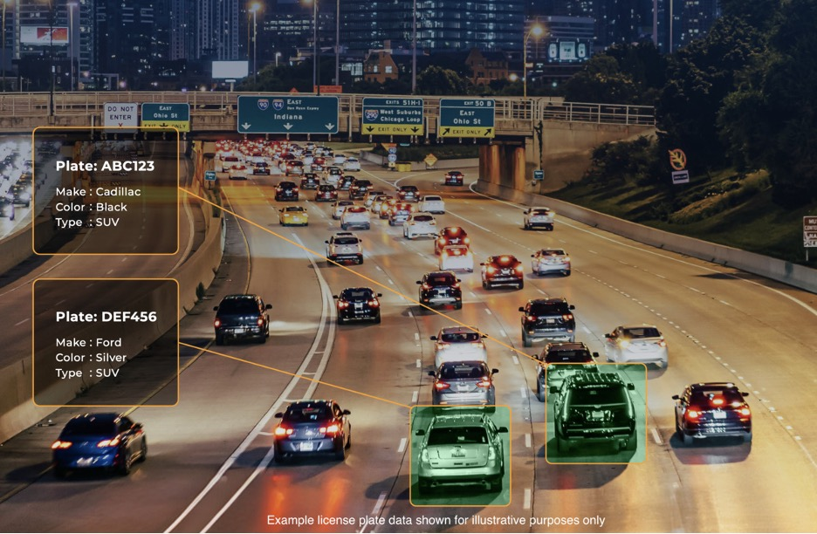
INTRODUCTION

Slide 3
LPR Project Pipeline
01
02
03
04
PREPROCESSING
SEGMENATION
IMAGE ENHANCEMENT
INDIVIDUAL CHARACATER SEGMENTATION
Extraction & Matching
Result Visualization
character recognition
Outputs and readings

Slide 4
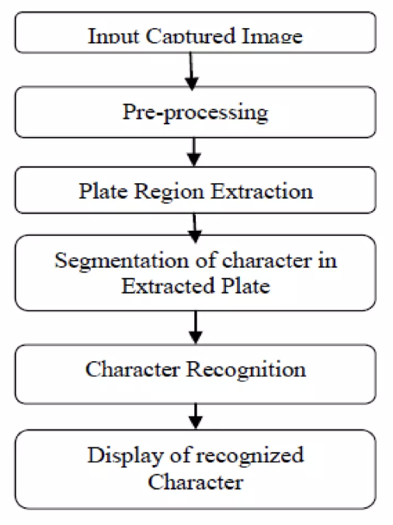
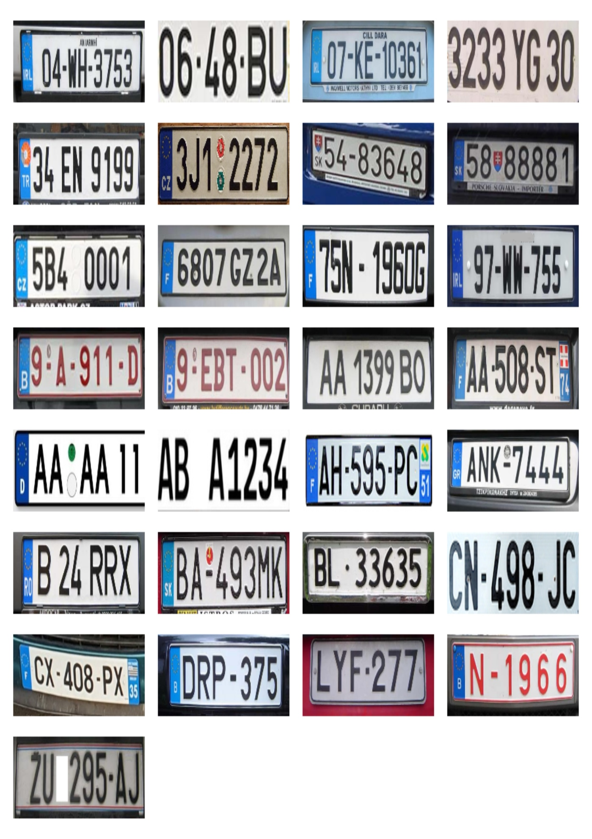
0) Input (DataSet)

Slide 5
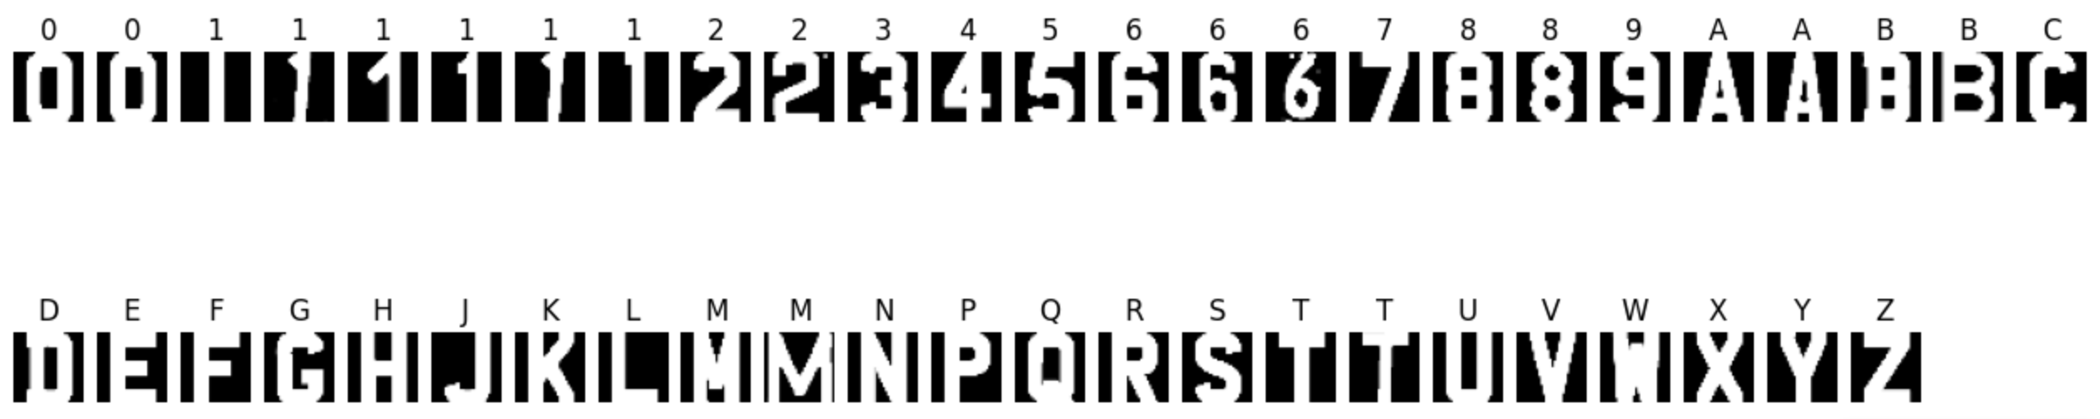
01) Preprocessing
Templates Processing and enhancement :
  Convert to grayscale and denoise using Gaussian blur.
  Apply adaptive thresholding + Otsu's method for binarization.
  Morphological operations (opening + closing) to remove noise and small gaps.
  Crop tightly to character bounding boxes and resize to 32x32 with padding.
  Apply dilation to normalize stroke width for all templates

Slide 6


01) Preprocessing
Test Plates Processing and enhancement:
  Convert to grayscale and enhance contrast using CLAHE.
  Apply sharpness correction if image is detected as blurry (is_blurry function).
  Binarization using adaptive threshold + Otsu.
  Morphological cleanup for better segmentation.

Slide 7
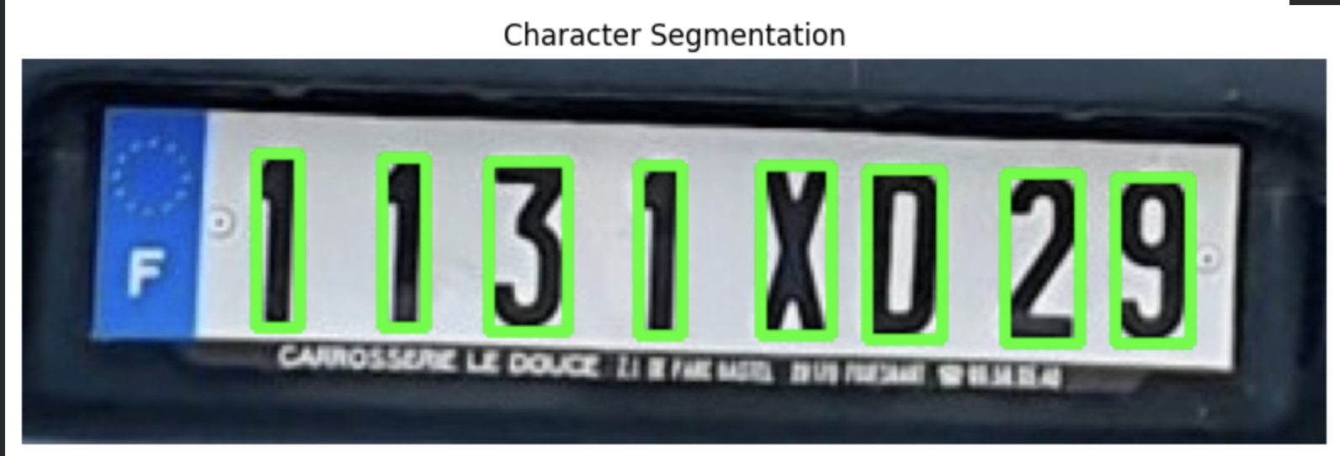
02) Segmentation
We used connected components to identify candidate characters.
Characters were filtered based on:
  Height and width relative to plate size.
  Aspect ratio constraints.
  Area proportion relative to plate.
Resize and normalize each segmented character to 32x32, with dilation.

Slide 8
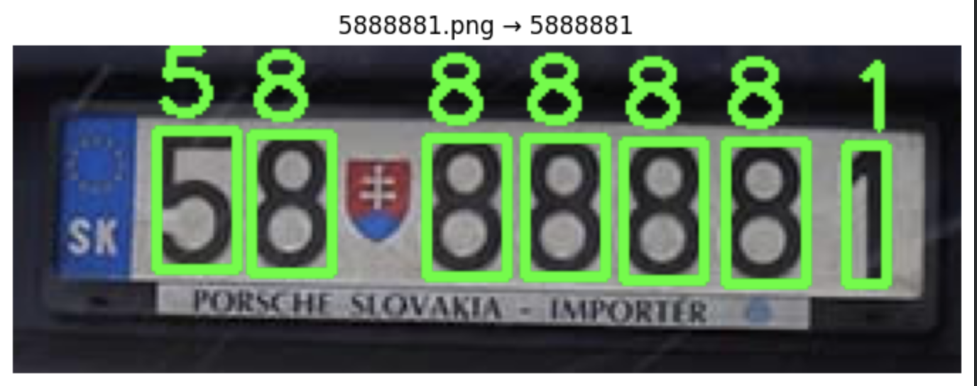
03) Feature Extraction & Matching
Extract HOG features for both templates and segmented characters.
Compare using Chi-square distance to find the best matching template.
Apply topology-based refinement for some characters:
  Ambiguous sets handled:
    8 ↔ B
    C ↔ G
    5 ↔ 6
    1 ↔ L
  Use Euler number (E) , connected components (C), number of holes (H) to resolve ambiguities.

Slide 9
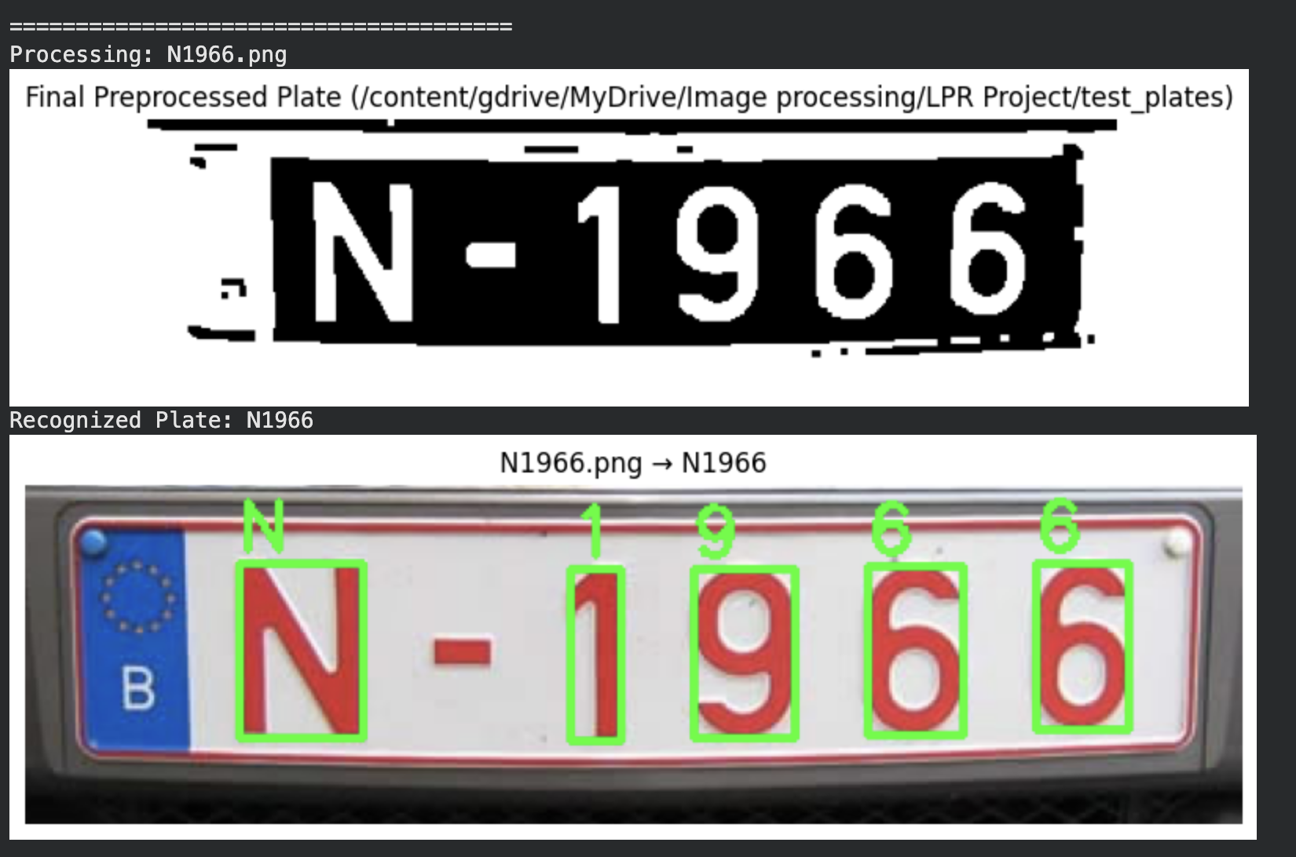
04) Output and visulization

Slide 10
Future Enhancements
Live tracking
Generalization
DEEP LEARNING
LIVE LICENSE PLATE RECOGNITION
MULTIPLE COUNTRIES LPR
DEEP LEARNING MODELS (YOLOV8)

Slide 11
Thank you
Project By :
Yehia hany SHORIM
2023/07891

